Slide 1


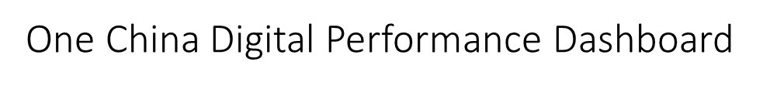






2018
Mar
Page 1/7
Cover Page
Philips One China Digital Dashboard
2018/03 Performance Review
Start here
BC&D China

Slide 2



2018
Mar
Page 2/7
Digital Performance Overview
The bounce rate is the percentage of visits with only 1 page view.
Highlight
Overall, we achieved great performance on most of the KPIs.
For “Review & Rating”, we deep rating to 4.3 (as global target), 4.5 (as China target) and 4.8 (as aggressive target) and more review responses to both negative and neutral reviews in JD.
The big achievement from B2B is the first success SQL.

Slide 3

2018
Mar
Page 3/7
Campaign Performance Overview
All Categories
The traffic to EC channel
Individual Campaign Performance Analysis
KA
Campaign name 1
Campaign name 1

Slide 4
2018
Mar
Page 3/7
Campaign Performance Overview Graphic
Back
折线图
去年与今年同比
今年Actual、去年同比Actual、今年Target
Impression
Traffic
CTR
Leads
Cost per lead
Conversion

Slide 5
2018
Mar
Page 3/7
Individual Campaign Performance Graphic
Back
Campaign name 1
折线图
共五根线（每个渠道一根线、Total一根线）
Impression
Traffic
CTR
Leads
Cost per lead
Conversion

Slide 6
2018
Mar
Page 4/7
Dotcom Performance Overview
B2C
B2B

Slide 7
2018
Mar
Page 5/7
CRM Performance Overview
Highlight
The big achievement from B2B is the first success SQL.

Slide 8
2018
Mar
Page 6/7
Review & Rating Performance Overview
All Channels
Year-to-date
By month
Highlight
For “Review & Rating”, we deep rating to 4.3 (as global target), 4.5 (as China target) and 4.8 (as aggressive target) and more review responses to both negative and neutral reviews in JD.

Slide 9
2018
Mar
Page 3/7
Review & Rating Performance Overview
Back
Performance
柱状图
三根基线（4.8绿、4.5橙、4.3蓝）
每个Category一根柱子

Slide 10
2018
Mar
Page 7/7
eCommerce Performance Overview

Slide 11




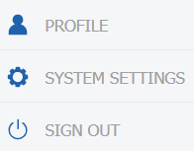
Cover Page
Page 1/7
Overview
Campaign
Cover page
Dotcom
CRM
Rating & Review
eCommerce
Philips One China Digital Dashboard
2018/03 Performance Review
Start here
BC&D China

Slide 12
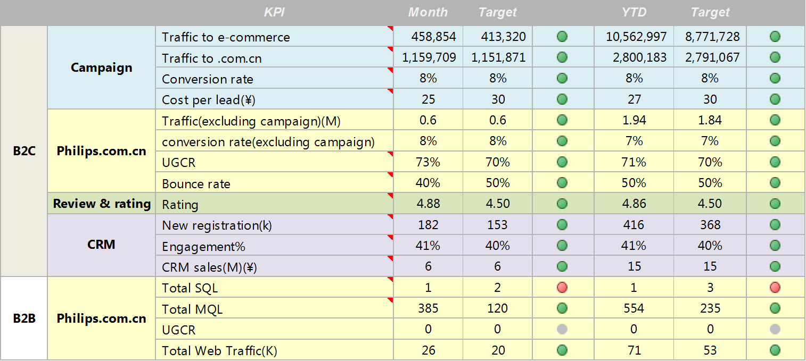
Cover Page
Page 2/7
Overview
Campaign
Digital Performance Overview
Dotcom
CRM
Rating & Review
eCommerce
Highlight
Overall, we achieved great performance on most of the KPIs.
For “Review & Rating”, we deep rating to 4.3 (as global target), 4.5 (as China target) and 4.8 (as aggressive target) and more review responses to both negative and neutral reviews in JD.
The big achievement from B2B is the first success SQL.

Slide 13
When rotate screen
Cover Page
Overview
Page 2/7
Campaign
Digital Performance Overview
Dotcom
CRM
Rating & Review
eCommerce
Highlight
Overall, we achieved great performance on most of the KPIs.
For “Review & Rating”, we deep rating to 4.3 (as global target), 4.5 (as China target) and 4.8 (as aggressive target) and more review responses to both negative and neutral reviews in JD.

Slide 14


Cover Page
Page 3/7
Overview
Campaign
Campaign Performance Overview
Dotcom
CRM
Rating & Review
eCommerce
Individual Campaign Performance Analysis

Slide 15
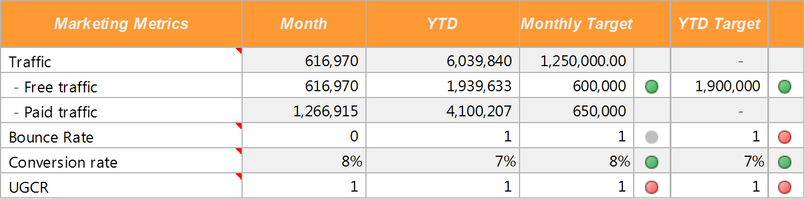
Cover Page
Page 4/7
Overview
Campaign
Dotcom Performance Overview
Dotcom
CRM
B2C
Rating & Review
eCommerce
B2B

Slide 16
Cover Page
Page 5/7
Overview
Campaign
CRM Performance Overview
Dotcom
CRM
Rating & Review
eCommerce
Highlight
The big achievement from B2B is the first success SQL.

Slide 17

Cover Page
Page 6/7
Overview
Campaign
Review & Rating Performance Overview
Dotcom
CRM
Rating & Review
Year-to-date
eCommerce
By month
Highlight
For “Review & Rating”, we deep rating to 4.3 (as global target), 4.5 (as China target) and 4.8 (as aggressive target) and more review responses to both negative and neutral reviews in JD.

Slide 18
Cover Page
Page 7/7
Overview
Campaign
eCommerce Performance Overview
Dotcom
CRM
Rating & Review
eCommerce

